Slide 1
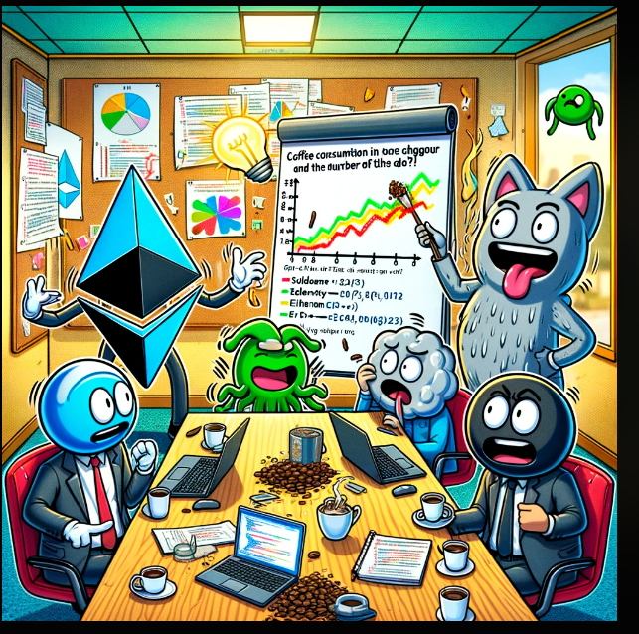
Swift_Minters nft Marketplace
RICE UNIVERSITY VIRTUAL-FIN-TECH
Joseph Amo Appiah
Shitanshu Eriwal
Brian Keys
Joel Williams

Slide 2
obJECTIVES
Introduce the purpose and power of non-fungible tokens (NFTs)
01
Describe the NFT marketplace
02
Demonstrate the process of creating and purchasing a NFT
03

Slide 3
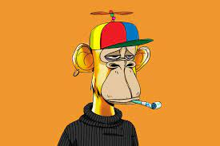



What are Nfts
Quantum
1st NFT Created on Namecoin
Ethereum blockchain
1st NFT Collections Launched
2016
2021
2014
2017
Rare Pepes
1st Crypto Art Market
Bored Ape Yacht Club
Avatar obsession that helped solidify NFTs
Notes:
NFTs are unique digital identifier that is recorded on a blockchain and is used to certify ownership and authenticity
The technology used was a Smart contract and in 2017 the Ethereum blockchain had its own take for those contracts
ERC-721 an open standard thar describes how to build nft tokens on EVM (Ethereum Virtual Machine) compatible blockchains
2014 – Quantum is the world’s 1st NFT
2016 – Rare Pepes: Collectible cards that helped create the 1st crypto art market
2017 – CryptoPunks: One of the most populare early generative are projects. Inspiration for the ERC-721
2021 – Bored Ape Yacht Club: Started the avatar craze and cementing NFTs as a pop culture phenomenon
Before Bitcoin was an ETF , in 2014 it was the first to have a image, The technology used was a Smart contract and in 2017 the Ethereum blockchain had its own take for those contracts
Those technologies are Ethereum Request for Comment known as ERC standards, created in the decentralized web environments for peer-to peer tokens to have a standard.
Updated and approved in Openzepplin community Standards for contract creation are examined for it's decentralized intended use ERC-20
NFT created in ERC-20 are non-fungible or fungible assets that hold value in the Tokenconomy for creation of a sub-economy that shows it's true usefulness by way of Real estate sales, Artwork

Slide 4



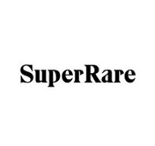

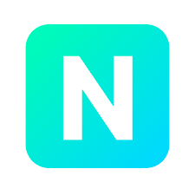

What is a Nft Marketplace?
Notes:
Specialized platforms that facilitate the buying, selling, and creation of Non-Fungible Tokens (NFTs)
These are unique digital assets representing ownership of distinct and scarce items that are tangible and intangible

Slide 5


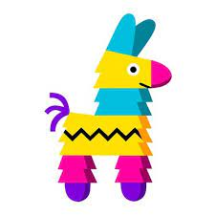
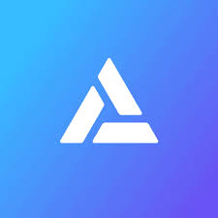

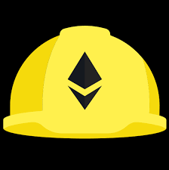
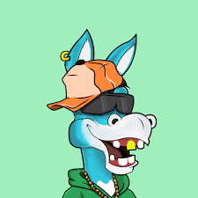
NFT Marketplace PROCESS Mapping
Notes:
A marketplace that connect the buyers and sellers of NFT
Helps them find a price and provides utilities for smooth transactions
Structure of the NFT Marketplace
1. Frontend
2. Smart Contract
Decentralized Data Storage
Prerequisities
ReactjS
Tailwind CSS
What do you need to develop an NFT marketplace
Solidity
A Node – Alchemy
IPFS
A developer wallet like Metamask with crypto on it
Frontend website
Apicture of PenSea which is an NFT market place and their layoyt

Slide 6
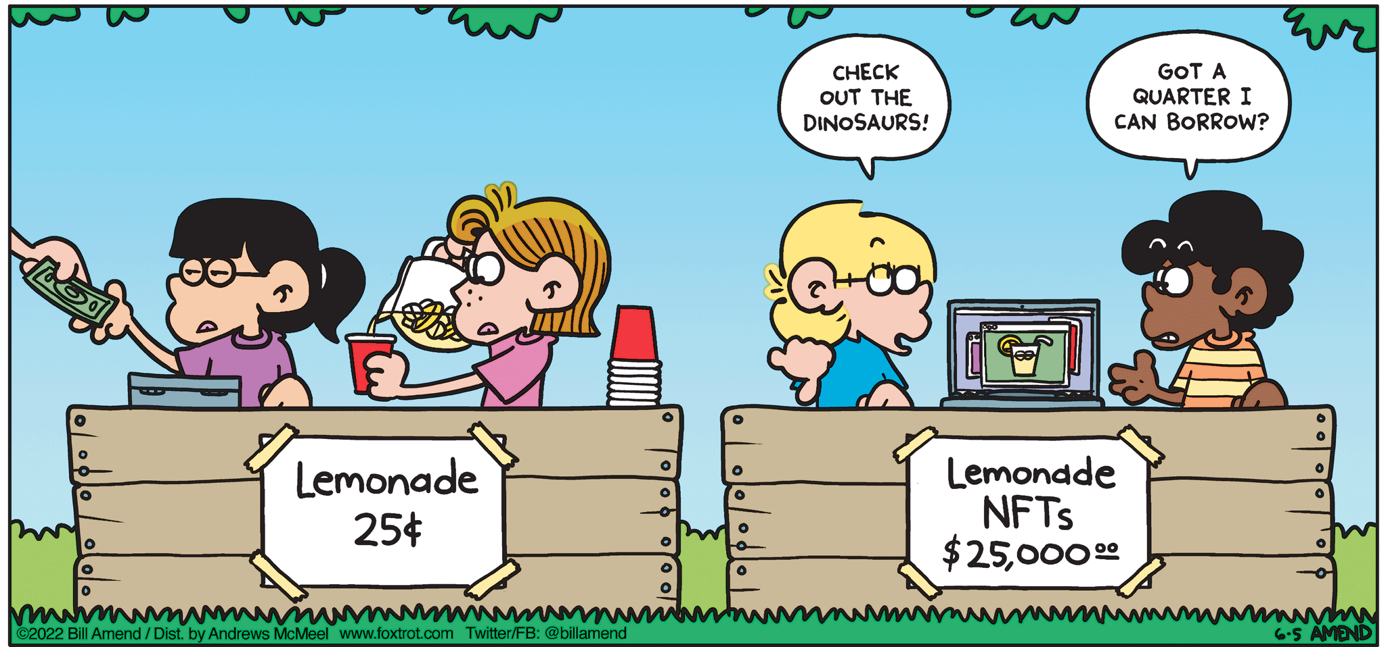
CLOSING REMARKS
Non-fungible tokens (NFT) are exclusive digital record that allows secure means of making transactions on the block-chain
NFT marketplace is a online digital platform that allows the buy, sell, and trade of NFTs
Notes:
NFTs allow artists to establish ownership of their digital creations and ensure that they are not duplicated or passed off as someone else’s work. Establish authenticity, NFT’s also provide a way to trace the ownership history of a particular digital asset

Slide 7
Thank you

